Slide 1
Introduction to ES6

Slide 2
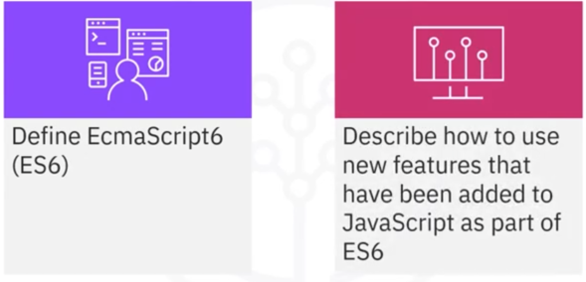
What you will learn

Slide 3
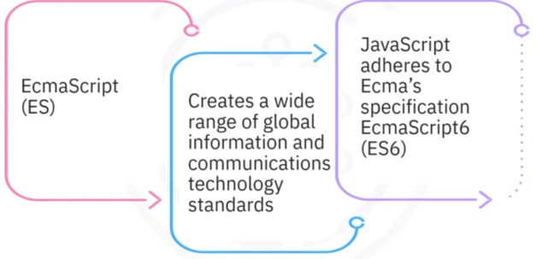
ES6 standard

Slide 4

JavaScript ES6: New features
Let
const
Arrows function
class
Promise

Slide 5


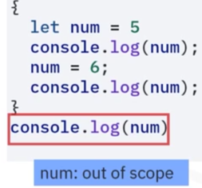
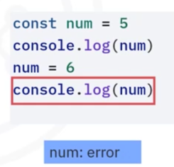
Keywords: let and const

Slide 6


Arrow functions
Similar to calling variables
Shorter and cleaner way to work with functions

Slide 7
Arrow functions
Similar to calling variables
Shorter and cleaner way to work with functions

Slide 8
Calling arrow functions
• Arrow functions can be called
• Arrow functions can be passed as parameters for callbacks
• Pass sayHe110() as a callback parameter to set Timeout()

Slide 9
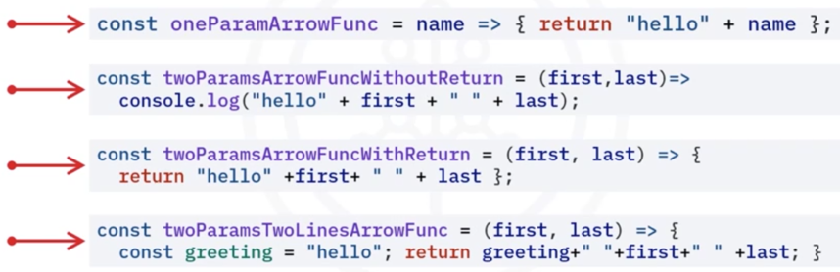
Arrow functions with parameters
• Take parameters like normal functions
• Can return a data type or an object

Slide 10

Promise
• Object which represents the completion of
an asynchronous operation and its return
value
• After invoking, a promise is in the pending
state
• After successful execution, the promise is
fulfilled
• If the operation fails, the promise is
rejected

Slide 11
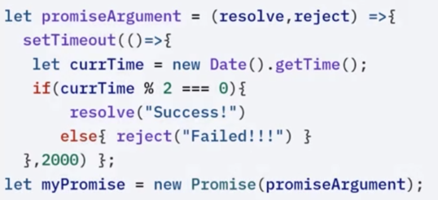
Promise example
Function with two parameters:

Slide 12
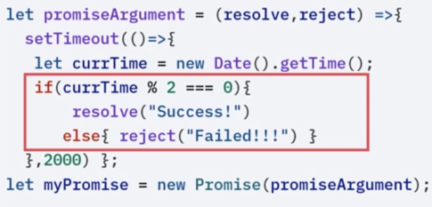
Promise example

Slide 13
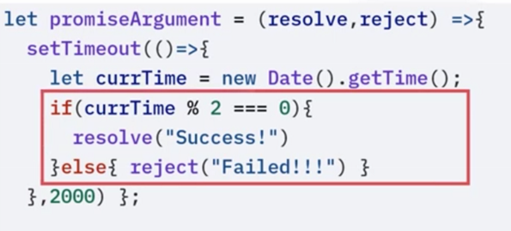
Promise example

Slide 14
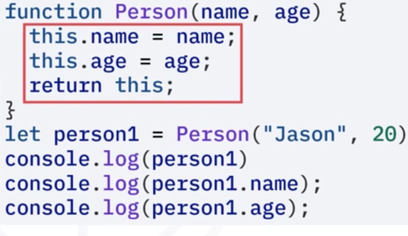
Classes
• Makes object-oriented
programming feasible
• Blueprint for creating
objects
• Built on prototypes in
JavaScript

Slide 15
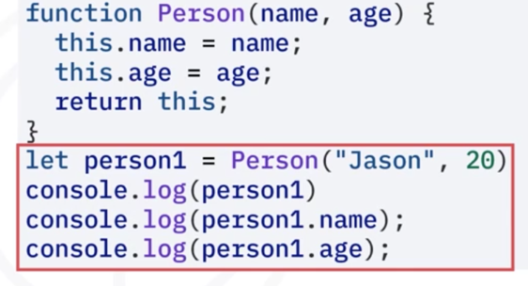
Classes
• Makes object-oriented
programming feasible
• Blueprint for creating
objects
• Built on prototypes in
JavaScript

Slide 16
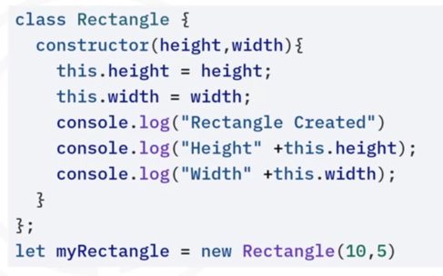
Classes
• Constructor: method
that creates an object
of a class
• Body: contained in
curly brackets

Slide 17
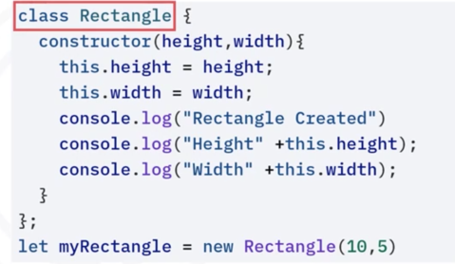
Class
• Constructor: method
that creates an object
of a class
• Body: contained in
curly brackets

Slide 18
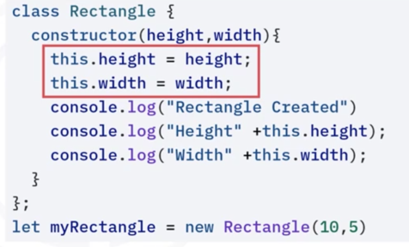
Class
• Constructor: method
that creates an object
of a class
• Body: contained in
curly brackets

Slide 19
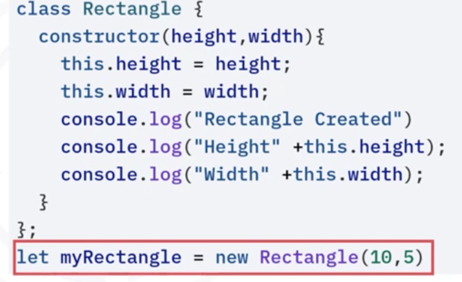
Class
• Constructor: method
that creates an object
of a class
• Body: contained in
curly brackets
class Rectangle {
constructor (height , width) {
• Object: Create using a
new keyword

Slide 20
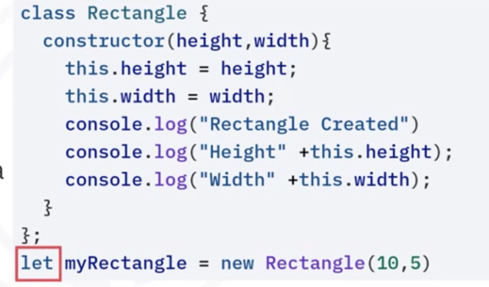
Class
• Constructor: method
that creates an object
of a class
• Body: contained in
curly brackets
class Rectangle {
constructor (height , width) {
• Object: Create using a
new keyword

Slide 21
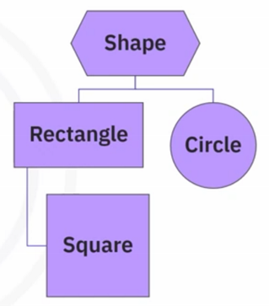
Inheritance
• A class can inherit from another class
• The subclass inherits from its class
• The subclass inherits all the
attributes and methods of the
superclass

Slide 22
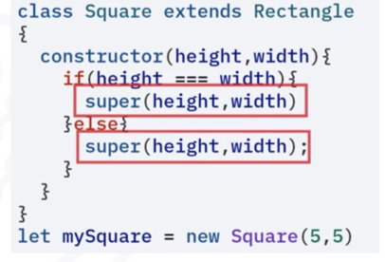
Inheritance
• The subclass may call the
superclass constructor with a
super() method call

Slide 23
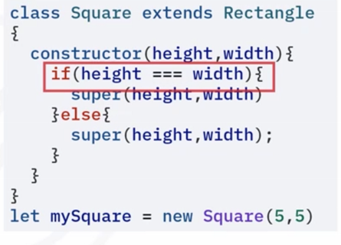
Inheritance
• The subclass may call the
superclass constructor with a
super() method call

Slide 24
Recap
In this video, you learned that:
• New features that were introduced in JavaScript as a part of ES6
are let, const, arrow functions, promise, and class
• You can create different types of arrow functions depending on
the parameters, return values, and lines of code
• Object-oriented programming was made feasible in JavaScript
with the introduction of class

